Slide 1
MODERN OPERATING SYSTEMS
Third Edition
ANDREW S. TANENBAUM
Chapter 5
Input/Output
Tanenbaum, Modern Operating Systems 3 e, (c) 2008 Prentice-Hall, Inc. All rights reserved. 0-13-6006639

Slide 2
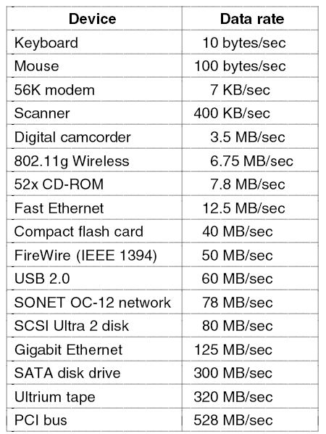
I/O Devices
Figure 5-1. Some typical device, network, and bus data rates.
Tanenbaum, Modern Operating Systems 3 e, (c) 2008 Prentice-Hall, Inc. All rights reserved. 0-13-6006639

Slide 3
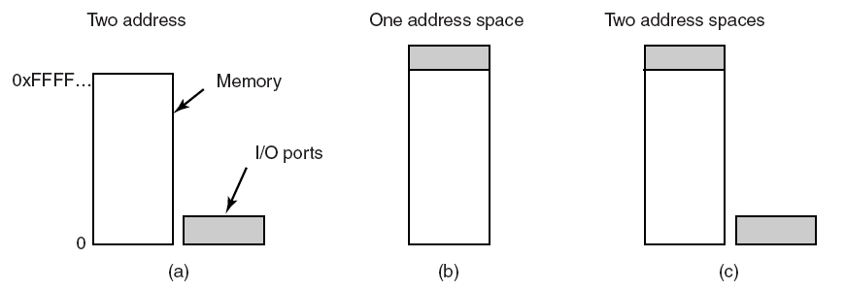
Memory-Mapped I/O (1)
Figure 5-2. (a) Separate I/O and memory space.
(b) Memory-mapped I/O. (c) Hybrid.
Tanenbaum, Modern Operating Systems 3 e, (c) 2008 Prentice-Hall, Inc. All rights reserved. 0-13-6006639

Slide 4
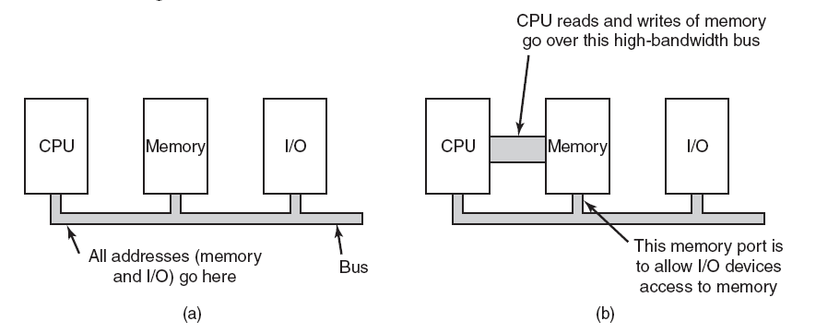
Memory-Mapped I/O (2)
Figure 5-3. (a) A single-bus architecture.
(b) A dual-bus memory architecture.
Tanenbaum, Modern Operating Systems 3 e, (c) 2008 Prentice-Hall, Inc. All rights reserved. 0-13-6006639

Slide 5
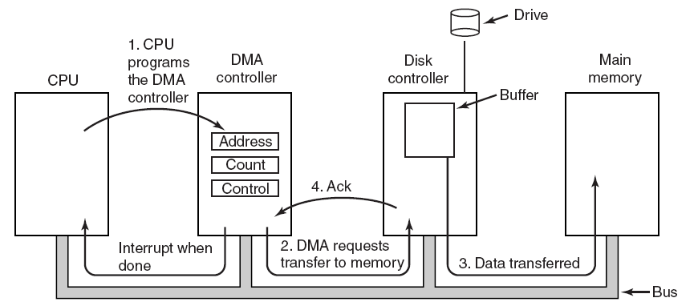
Direct Memory Access (DMA)
Figure 5-4. Operation of a DMA transfer.
Tanenbaum, Modern Operating Systems 3 e, (c) 2008 Prentice-Hall, Inc. All rights reserved. 0-13-6006639

Slide 6
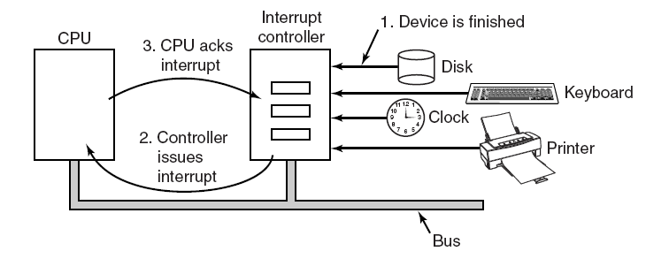
Interrupts Revisited
Figure 5-5. How an interrupt happens. The connections between the devices and the interrupt controller actually use interrupt lines on the bus rather than dedicated wires.
Tanenbaum, Modern Operating Systems 3 e, (c) 2008 Prentice-Hall, Inc. All rights reserved. 0-13-6006639

Slide 7
Precise and Imprecise Interrupts (1)
Properties of a precise interrupt
PC (Program Counter) is saved in a known place.
All instructions before the one pointed to by the PC have fully executed.
No instruction beyond the one pointed to by the PC has been executed.
Execution state of the instruction pointed to by the PC is known.
Tanenbaum, Modern Operating Systems 3 e, (c) 2008 Prentice-Hall, Inc. All rights reserved. 0-13-6006639

Slide 8
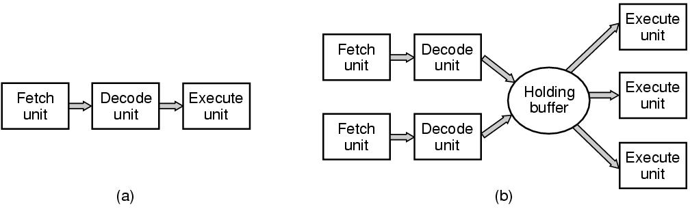
CPU Pipelining
Figure 1-7. (a) A three-stage pipeline. (b) A superscalar CPU.
Tanenbaum, Modern Operating Systems 3 e, (c) 2008 Prentice-Hall, Inc. All rights reserved. 0-13-6006639

Slide 9
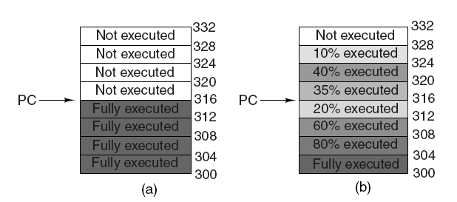
Precise and Imprecise Interrupts (2)
Figure 5-6. (a) A precise interrupt. (b) An imprecise interrupt.
Tanenbaum, Modern Operating Systems 3 e, (c) 2008 Prentice-Hall, Inc. All rights reserved. 0-13-6006639

Slide 10
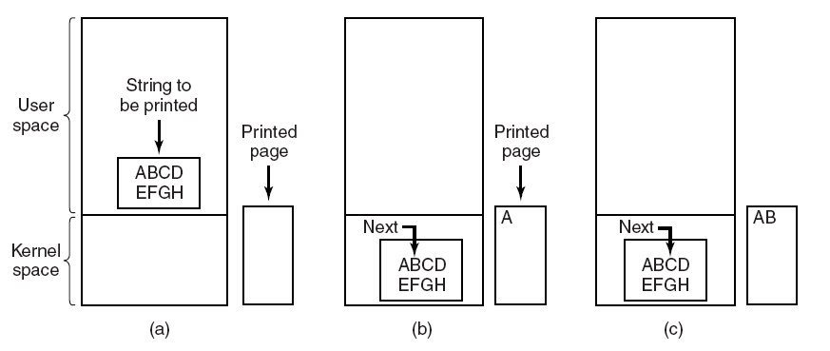
Programmed I/O (1)
Figure 5-7. Steps in printing a string.
Tanenbaum, Modern Operating Systems 3 e, (c) 2008 Prentice-Hall, Inc. All rights reserved. 0-13-6006639

Slide 11
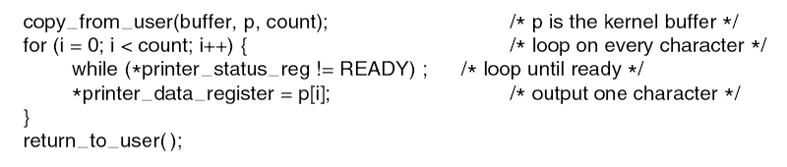
Programmed I/O (2)
Figure 5-8. Writing a string to the printer using programmed I/O.
Tanenbaum, Modern Operating Systems 3 e, (c) 2008 Prentice-Hall, Inc. All rights reserved. 0-13-6006639

Slide 12
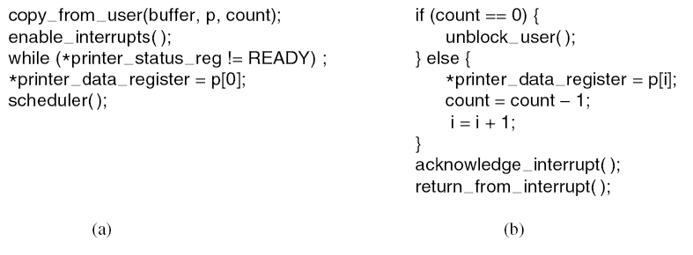
Interrupt-Driven I/O
Figure 5-9. Writing a string to the printer using interrupt-driven I/O. (a) Code executed at the time the print system call is made. (b) Interrupt service procedure for the printer.
Tanenbaum, Modern Operating Systems 3 e, (c) 2008 Prentice-Hall, Inc. All rights reserved. 0-13-6006639

Slide 13
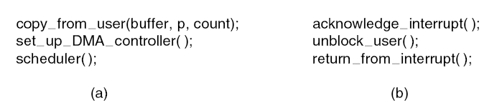
I/O Using DMA
Figure 5-10. Printing a string using DMA. (a) Code executed when the print system call is made. (b) Interrupt service procedure.
Tanenbaum, Modern Operating Systems 3 e, (c) 2008 Prentice-Hall, Inc. All rights reserved. 0-13-6006639

Slide 14
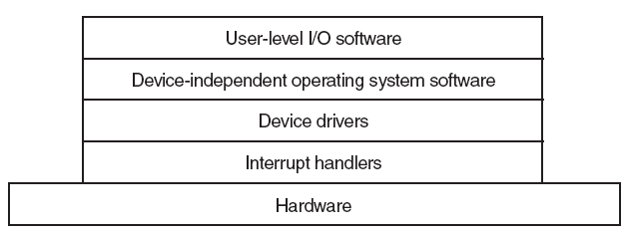
I/O Software Layers
Figure 5-11. Layers of the I/O software system.
Tanenbaum, Modern Operating Systems 3 e, (c) 2008 Prentice-Hall, Inc. All rights reserved. 0-13-6006639

Slide 15
Interrupt Handlers (1)
Save registers not already been saved by interrupt hardware.
Set up a context for the interrupt service procedure.
Set up a stack for the interrupt service procedure.
Acknowledge the interrupt controller. If there is no centralized interrupt controller, reenable interrupts.
Copy the registers from where they were saved to the process table.
Tanenbaum, Modern Operating Systems 3 e, (c) 2008 Prentice-Hall, Inc. All rights reserved. 0-13-6006639

Slide 16
Interrupt Handlers (2)
Run the interrupt service procedure.
Choose which process to run next.
Set up the MMU context for the process to run next.
Load the new process’ registers, including its PSW.
Start running the new process.
Tanenbaum, Modern Operating Systems 3 e, (c) 2008 Prentice-Hall, Inc. All rights reserved. 0-13-6006639

Slide 17
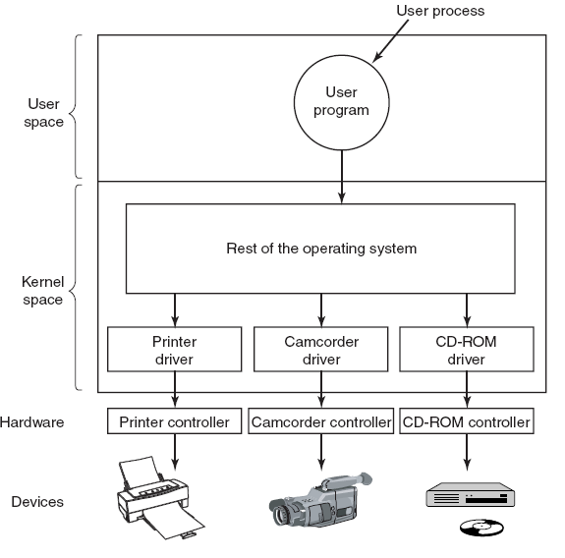
Device Drivers
Figure 5-12. Logical positioning of device drivers. In reality all communication between drivers and device controllers goes over the bus.
Tanenbaum, Modern Operating Systems 3 e, (c) 2008 Prentice-Hall, Inc. All rights reserved. 0-13-6006639

Slide 18
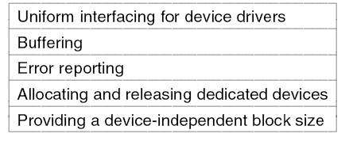
Device-Independent I/O Software
Figure 5-13. Functions of the device-independent I/O software.
Tanenbaum, Modern Operating Systems 3 e, (c) 2008 Prentice-Hall, Inc. All rights reserved. 0-13-6006639

Slide 19
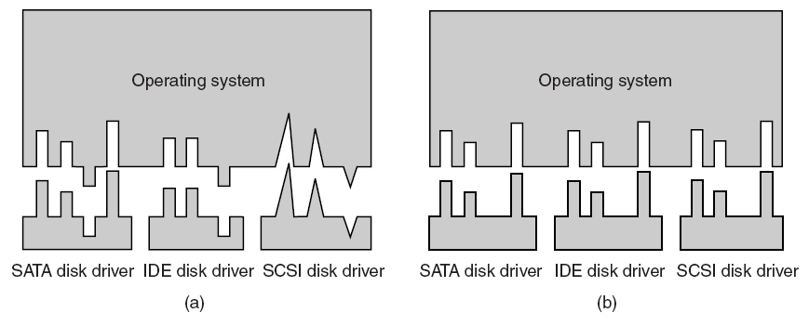
Uniform Interfacing for Device Drivers
Figure 5-14. (a) Without a standard driver interface.
(b) With a standard driver interface.
Tanenbaum, Modern Operating Systems 3 e, (c) 2008 Prentice-Hall, Inc. All rights reserved. 0-13-6006639

Slide 20
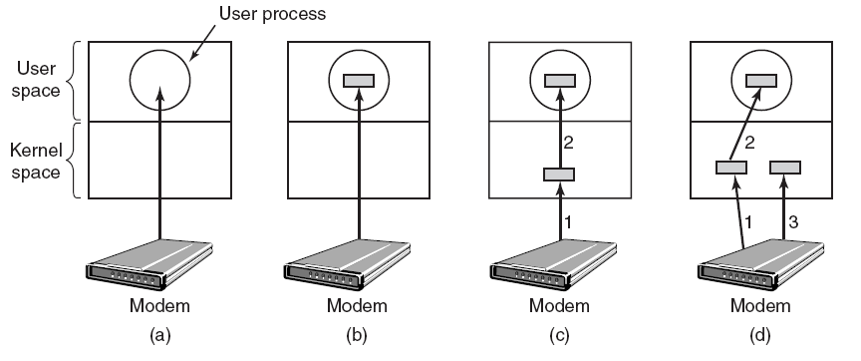
Buffering (1)
Figure 5-15. (a) Unbuffered input. (b) Buffering in user space.
(c) Buffering in the kernel followed by copying to user space. (d) Double buffering in the kernel.
Tanenbaum, Modern Operating Systems 3 e, (c) 2008 Prentice-Hall, Inc. All rights reserved. 0-13-6006639

Slide 21
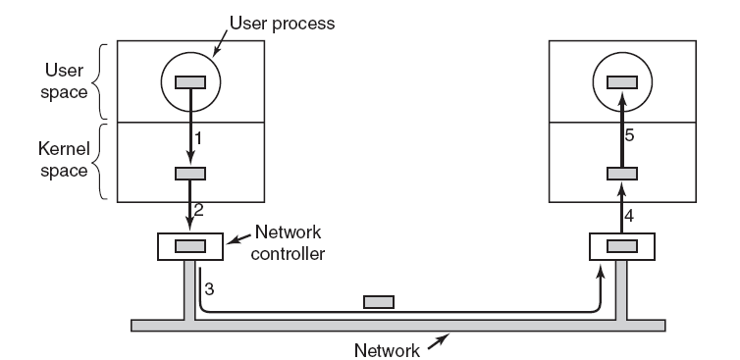
Buffering (2)
Figure 5-16. Networking may involve many copies of a packet.
Tanenbaum, Modern Operating Systems 3 e, (c) 2008 Prentice-Hall, Inc. All rights reserved. 0-13-6006639

Slide 22
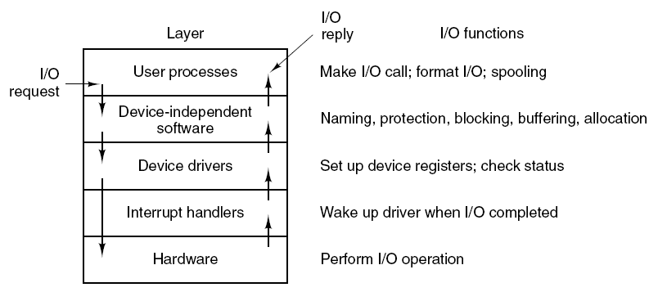
User-Space I/O Software
Figure 5-17. Layers of the I/O system and the
main functions of each layer.
Tanenbaum, Modern Operating Systems 3 e, (c) 2008 Prentice-Hall, Inc. All rights reserved. 0-13-6006639

Slide 23
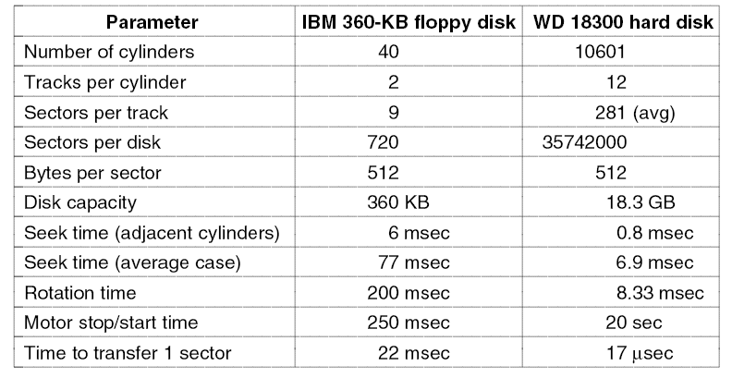
Magnetic Disks (1)
Figure 5-18. Disk parameters for the original IBM PC 360-KB floppy disk and a Western Digital WD 18300 hard disk.
Tanenbaum, Modern Operating Systems 3 e, (c) 2008 Prentice-Hall, Inc. All rights reserved. 0-13-6006639

Slide 24
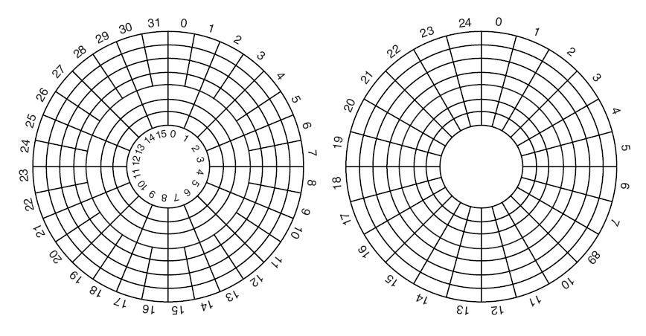
Magnetic Disks (2)
Figure 5-19. (a) Physical geometry of a disk with two zones.
(b) A possible virtual geometry for this disk.
Tanenbaum, Modern Operating Systems 3 e, (c) 2008 Prentice-Hall, Inc. All rights reserved. 0-13-6006639

Slide 25
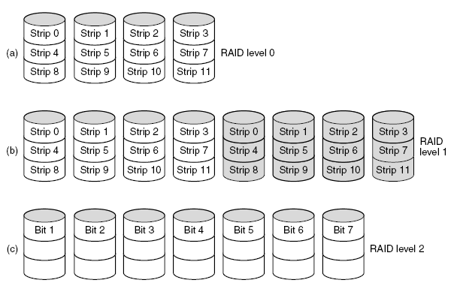
RAID (1)
Figure 5-20. RAID levels 0 through 5.
Backup and parity drives are shown shaded.
Tanenbaum, Modern Operating Systems 3 e, (c) 2008 Prentice-Hall, Inc. All rights reserved. 0-13-6006639

Slide 26
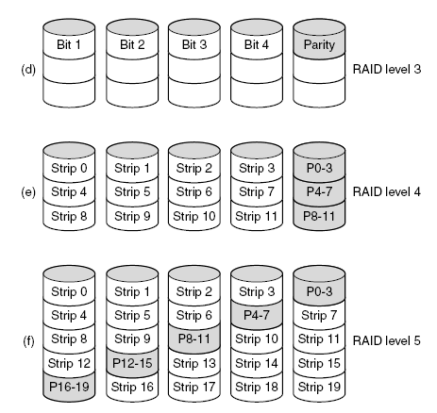
RAID (2)
Figure 5-20. RAID levels 0 through 5.
Backup and parity drives are shown shaded.
Tanenbaum, Modern Operating Systems 3 e, (c) 2008 Prentice-Hall, Inc. All rights reserved. 0-13-6006639

Slide 27
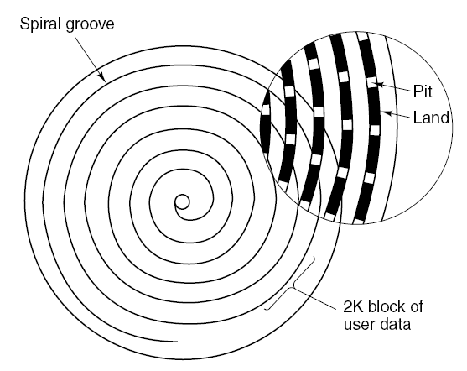
CD-ROMs (1)
Figure 5-21. Recording structure of a compact disc or CD-ROM.
Tanenbaum, Modern Operating Systems 3 e, (c) 2008 Prentice-Hall, Inc. All rights reserved. 0-13-6006639

Slide 28
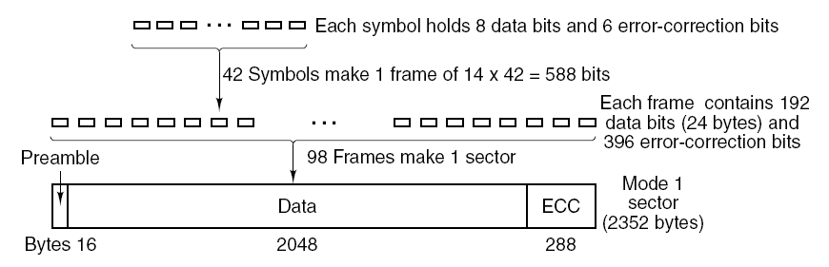
CD-ROMs (2)
Figure 5-22. Logical data layout on a CD-ROM.
Tanenbaum, Modern Operating Systems 3 e, (c) 2008 Prentice-Hall, Inc. All rights reserved. 0-13-6006639

Slide 29
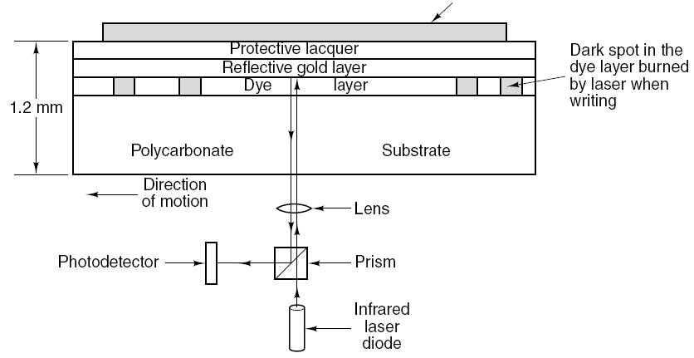
CD-Recordables (1)
Figure 5-23. Cross section of a CD-R disk and laser. A silver
CD-ROM has similar structure, except without dye layer and with pitted aluminum layer instead of gold layer.
Tanenbaum, Modern Operating Systems 3 e, (c) 2008 Prentice-Hall, Inc. All rights reserved. 0-13-6006639

Slide 30
DVD (1)
DVD Improvements on CDs
Smaller pits
(0.4 microns versus 0.8 microns for CDs).
A tighter spiral
(0.74 microns between tracks versus 1.6 microns for CDs).
A red laser
(at 0.65 microns versus 0.78 microns for CDs).
Tanenbaum, Modern Operating Systems 3 e, (c) 2008 Prentice-Hall, Inc. All rights reserved. 0-13-6006639

Slide 31
DVD (2)
DVD Formats
Single-sided, single-layer (4.7 GB).
Single-sided, dual-layer (8.5 GB).
Double-sided, single-layer (9.4 GB).
Double-sided, dual-layer (17 GB).
Tanenbaum, Modern Operating Systems 3 e, (c) 2008 Prentice-Hall, Inc. All rights reserved. 0-13-6006639

Slide 32
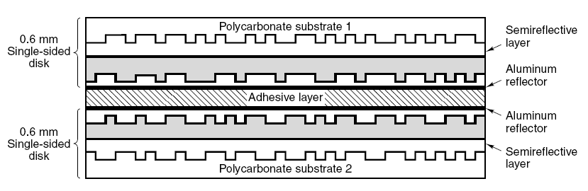
DVD (3)
Figure 5-24. A double-sided, dual-layer DVD disk.
Tanenbaum, Modern Operating Systems 3 e, (c) 2008 Prentice-Hall, Inc. All rights reserved. 0-13-6006639

Slide 33
Disk Formatting (1)
Figure 5-25. A disk sector.
Tanenbaum, Modern Operating Systems 3 e, (c) 2008 Prentice-Hall, Inc. All rights reserved. 0-13-6006639

Slide 34
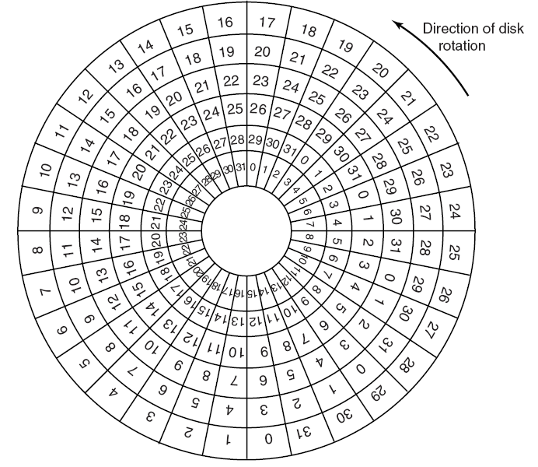
Disk Formatting (2)
Figure 5-26. An illustration of cylinder skew.
Tanenbaum, Modern Operating Systems 3 e, (c) 2008 Prentice-Hall, Inc. All rights reserved. 0-13-6006639

Slide 35
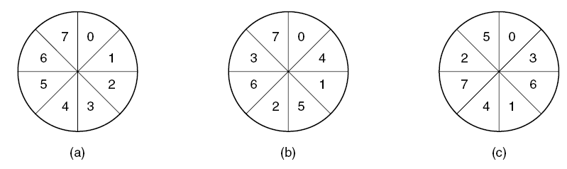
Disk Formatting (3)
Figure 5-27. (a) No interleaving. (b) Single interleaving.
(c) Double interleaving.
Tanenbaum, Modern Operating Systems 3 e, (c) 2008 Prentice-Hall, Inc. All rights reserved. 0-13-6006639

Slide 36
Disk Arm Scheduling Algorithms (1)
Read/write time factors
Seek time (the time to move the arm to the proper cylinder).
Rotational delay (the time for the proper sector to rotate under the head).
Actual data transfer time.
Tanenbaum, Modern Operating Systems 3 e, (c) 2008 Prentice-Hall, Inc. All rights reserved. 0-13-6006639

Slide 37
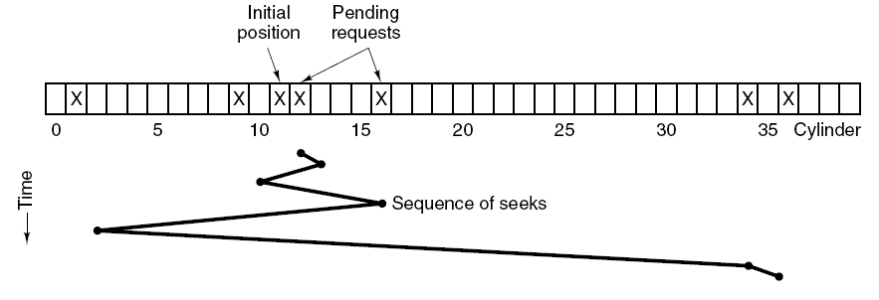
Disk Arm Scheduling Algorithms (2)
Figure 5-28. Shortest Seek First (SSF) disk scheduling algorithm (also known as Closest Cylinder Next)
Tanenbaum, Modern Operating Systems 3 e, (c) 2008 Prentice-Hall, Inc. All rights reserved. 0-13-6006639

Slide 38
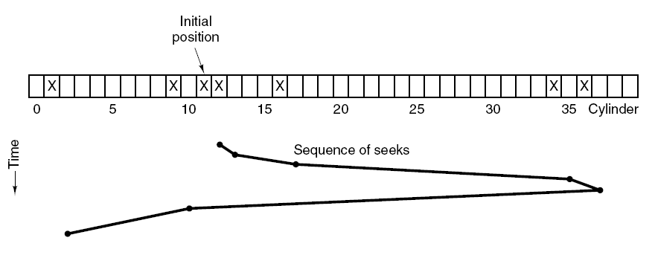
Disk Arm Scheduling Algorithms (3)
Figure 5-29. The elevator algorithm for scheduling disk requests.
Tanenbaum, Modern Operating Systems 3 e, (c) 2008 Prentice-Hall, Inc. All rights reserved. 0-13-6006639

Slide 39
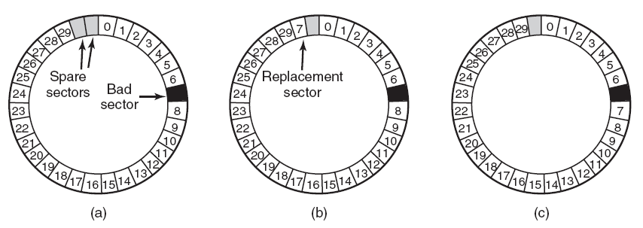
Error Handling
Figure 5-30. (a) A disk track with a bad sector.
(b) Substituting a spare for the bad sector.
(c) Shifting all the sectors to bypass the bad one.
Tanenbaum, Modern Operating Systems 3 e, (c) 2008 Prentice-Hall, Inc. All rights reserved. 0-13-6006639

Slide 40
Stable Storage (1)
Operations for stable storage using identical disks:
Stable writes
Stable reads
Crash recovery
Tanenbaum, Modern Operating Systems 3 e, (c) 2008 Prentice-Hall, Inc. All rights reserved. 0-13-6006639

Slide 41
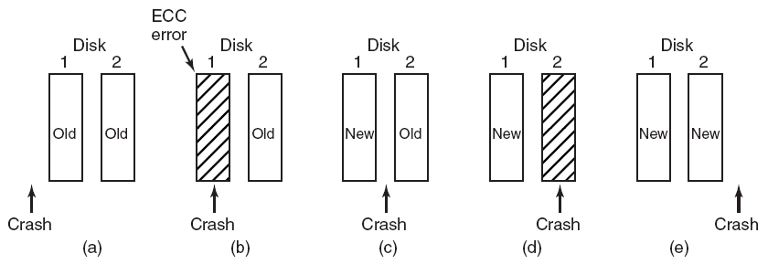
Stable Storage (2)
Figure 5-31. Analysis of the influence of crashes on stable writes.
Tanenbaum, Modern Operating Systems 3 e, (c) 2008 Prentice-Hall, Inc. All rights reserved. 0-13-6006639

Slide 42
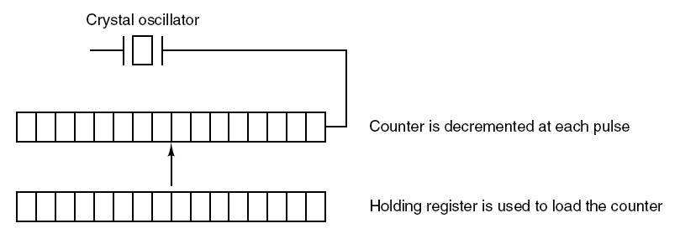
Clock Hardware
Figure 5-32. A programmable clock.
Tanenbaum, Modern Operating Systems 3 e, (c) 2008 Prentice-Hall, Inc. All rights reserved. 0-13-6006639

Slide 43
Clock Software (1)
Typical duties of a clock driver
Maintaining the time of day.
Preventing processes from running longer than they are allowed to.
Accounting for CPU usage.
Handling alarm system call made by user processes.
Providing watchdog timers for parts of the system itself.
Doing profiling, monitoring, statistics gathering.
Tanenbaum, Modern Operating Systems 3 e, (c) 2008 Prentice-Hall, Inc. All rights reserved. 0-13-6006639

Slide 44
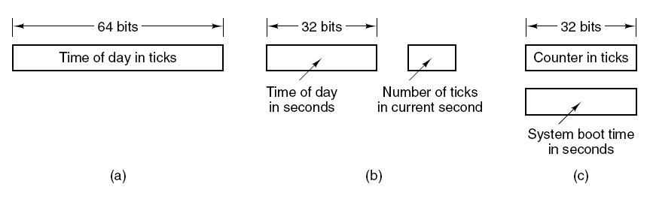
Clock Software (2)
Figure 5-33. Three ways to maintain the time of day.
Tanenbaum, Modern Operating Systems 3 e, (c) 2008 Prentice-Hall, Inc. All rights reserved. 0-13-6006639

Slide 45
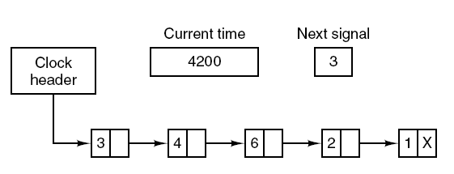
Clock Software (3)
Figure 5-34. Simulating multiple timers with a single clock.
Tanenbaum, Modern Operating Systems 3 e, (c) 2008 Prentice-Hall, Inc. All rights reserved. 0-13-6006639

Slide 46
Soft Timers
Soft timers succeed according to rate at which kernel entries are made because of:
System calls.
TLB misses.
Page faults.
I/O interrupts.
The CPU going idle.
Tanenbaum, Modern Operating Systems 3 e, (c) 2008 Prentice-Hall, Inc. All rights reserved. 0-13-6006639

Slide 47
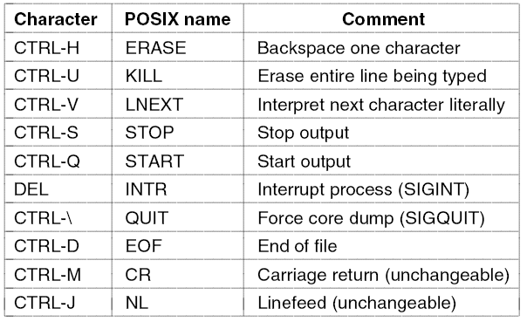
Keyboard Software
Figure 5-35. Characters that are handled
specially in canonical mode.
Tanenbaum, Modern Operating Systems 3 e, (c) 2008 Prentice-Hall, Inc. All rights reserved. 0-13-6006639

Slide 48
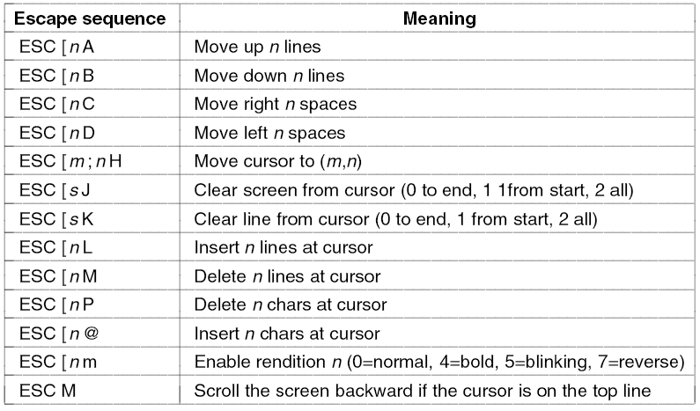
The X Window System (1)
Figure 5-36. The ANSI escape sequences accepted by the terminal driver on output. ESC denotes the ASCII escape character (0x1B), and n, m, and s are optional
numeric parameters.
Tanenbaum, Modern Operating Systems 3 e, (c) 2008 Prentice-Hall, Inc. All rights reserved. 0-13-6006639

Slide 49
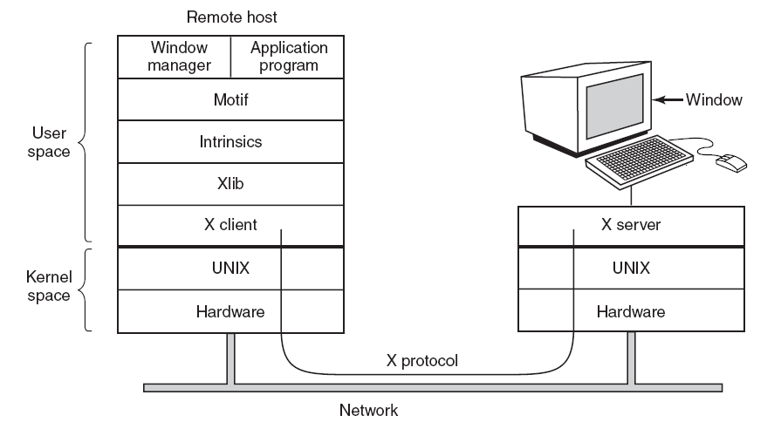
The X Window System (2)
Figure 5-37. Clients and servers in the M.I.T. X Window System.
Tanenbaum, Modern Operating Systems 3 e, (c) 2008 Prentice-Hall, Inc. All rights reserved. 0-13-6006639

Slide 50
The X Window System (3)
Types of messages between client and server:
Drawing commands from the program to the workstation.
Replies by the workstation to program queries.
Keyboard, mouse, and other event announcements.
Error messages.
Tanenbaum, Modern Operating Systems 3 e, (c) 2008 Prentice-Hall, Inc. All rights reserved. 0-13-6006639

Slide 51
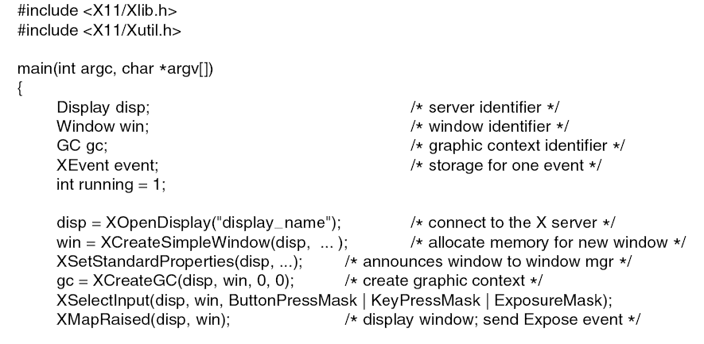
Graphical User Interfaces (1)
. . .
Figure 5-38. A skeleton of an X Window application program.
Tanenbaum, Modern Operating Systems 3 e, (c) 2008 Prentice-Hall, Inc. All rights reserved. 0-13-6006639

Slide 52
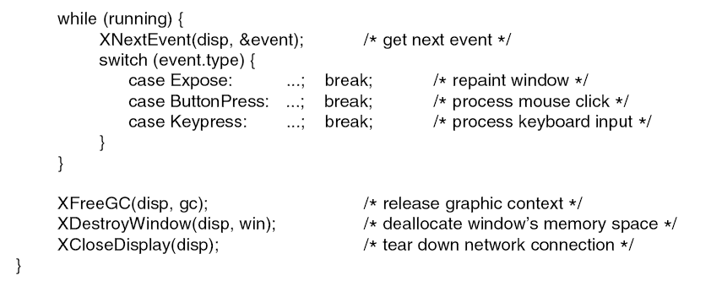
Graphical User Interfaces (2)
. . .
Figure 5-38. A skeleton of an X Window application program.
Tanenbaum, Modern Operating Systems 3 e, (c) 2008 Prentice-Hall, Inc. All rights reserved. 0-13-6006639

Slide 53
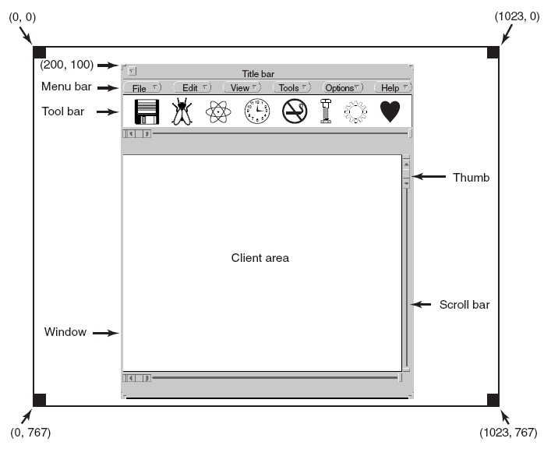
Graphical User Interfaces (3)
Figure 5-39. A sample window located at (200, 100) on an XGA display.
Tanenbaum, Modern Operating Systems 3 e, (c) 2008 Prentice-Hall, Inc. All rights reserved. 0-13-6006639

Slide 54
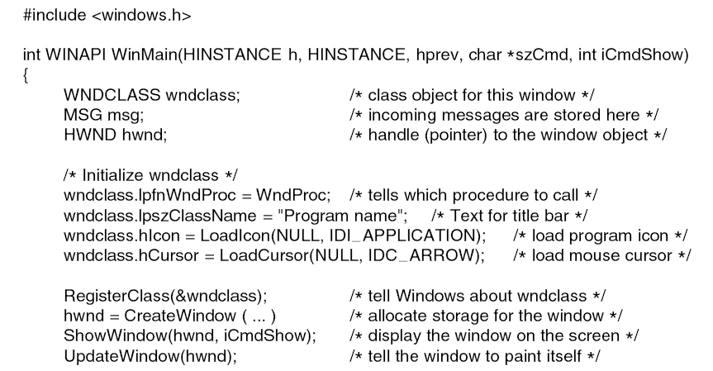
Graphical User Interfaces (4)
. . .
Figure 5-40. A skeleton of a Windows main program.
Tanenbaum, Modern Operating Systems 3 e, (c) 2008 Prentice-Hall, Inc. All rights reserved. 0-13-6006639

Slide 55
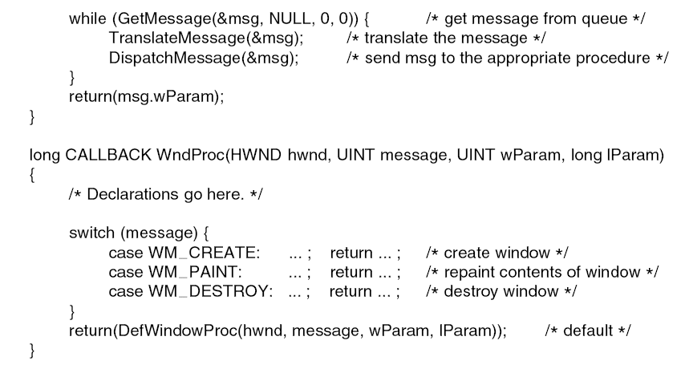
Graphical User Interfaces (5)
. . .
Figure 5-40. A skeleton of a Windows main program.
Tanenbaum, Modern Operating Systems 3 e, (c) 2008 Prentice-Hall, Inc. All rights reserved. 0-13-6006639

Slide 56
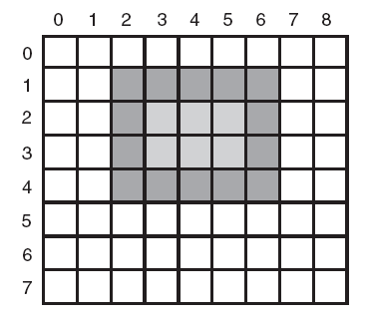
Bitmaps (1)
Figure 5-41. An example rectangle drawn using Rectangle.
Each box represents one pixel.
Tanenbaum, Modern Operating Systems 3 e, (c) 2008 Prentice-Hall, Inc. All rights reserved. 0-13-6006639

Slide 57
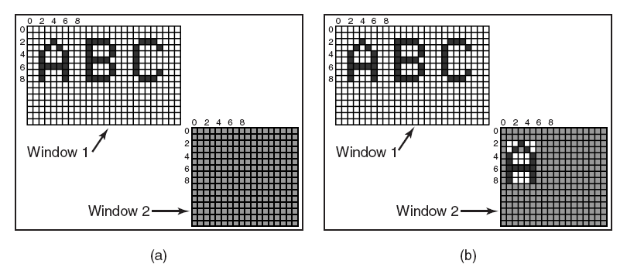
Bitmaps (2)
Figure 5-42. Copying bitmaps using BitBlt. (a) Before. (b) After.
Tanenbaum, Modern Operating Systems 3 e, (c) 2008 Prentice-Hall, Inc. All rights reserved. 0-13-6006639

Slide 58
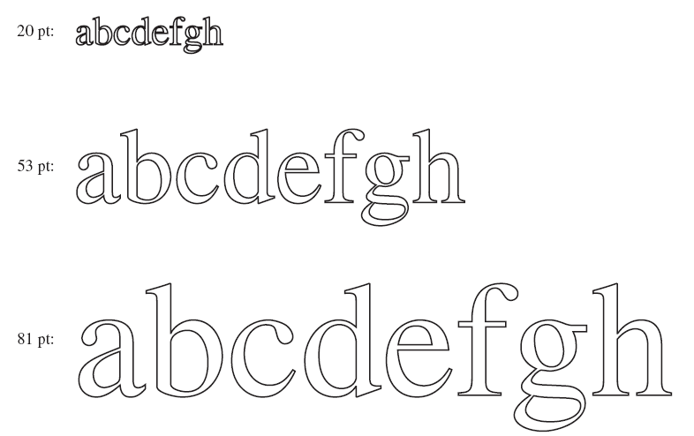
Fonts
Figure 5-43. Some examples of character outlines
at different point sizes.
Tanenbaum, Modern Operating Systems 3 e, (c) 2008 Prentice-Hall, Inc. All rights reserved. 0-13-6006639

Slide 59
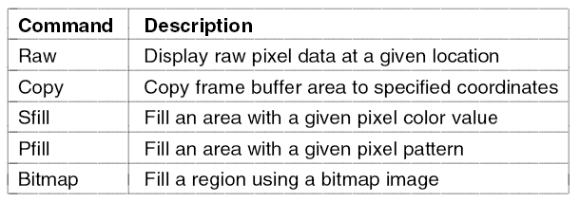
Thin Clients
Figure 5-44. The THINC protocol display commands.
Tanenbaum, Modern Operating Systems 3 e, (c) 2008 Prentice-Hall, Inc. All rights reserved. 0-13-6006639

Slide 60
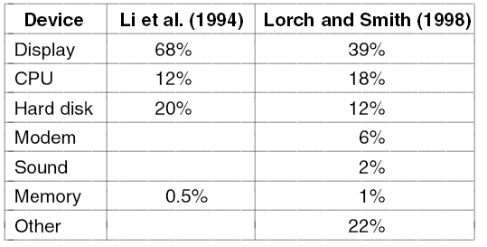
Power Management
Hardware Issues
Figure 5-45. Power consumption of various parts
of a notebook computer.
Tanenbaum, Modern Operating Systems 3 e, (c) 2008 Prentice-Hall, Inc. All rights reserved. 0-13-6006639

Slide 61
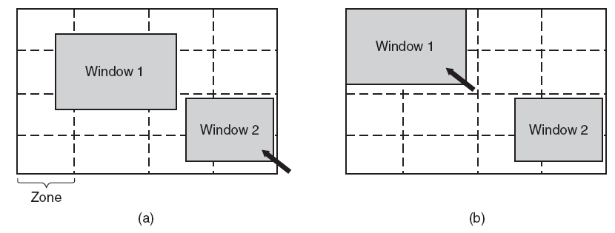
Power Management
The Display
Figure 5-46. The use of zones for backlighting the display.
(a) When window 2 is selected it is not moved.
(b) When window 1 is selected, it moves to reduce the number of zones illuminated.
Tanenbaum, Modern Operating Systems 3 e, (c) 2008 Prentice-Hall, Inc. All rights reserved. 0-13-6006639

Slide 62
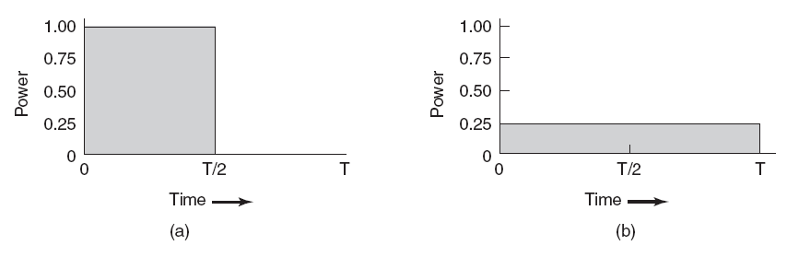
Power Management
The CPU
Figure 5-47. (a) Running at full clock speed. (b) Cutting voltage by two cuts clock speed by two and power consumption by four.
Tanenbaum, Modern Operating Systems 3 e, (c) 2008 Prentice-Hall, Inc. All rights reserved. 0-13-6006639

